Slide 1

Code Crate
Phase 3 Presentation

Slide 2

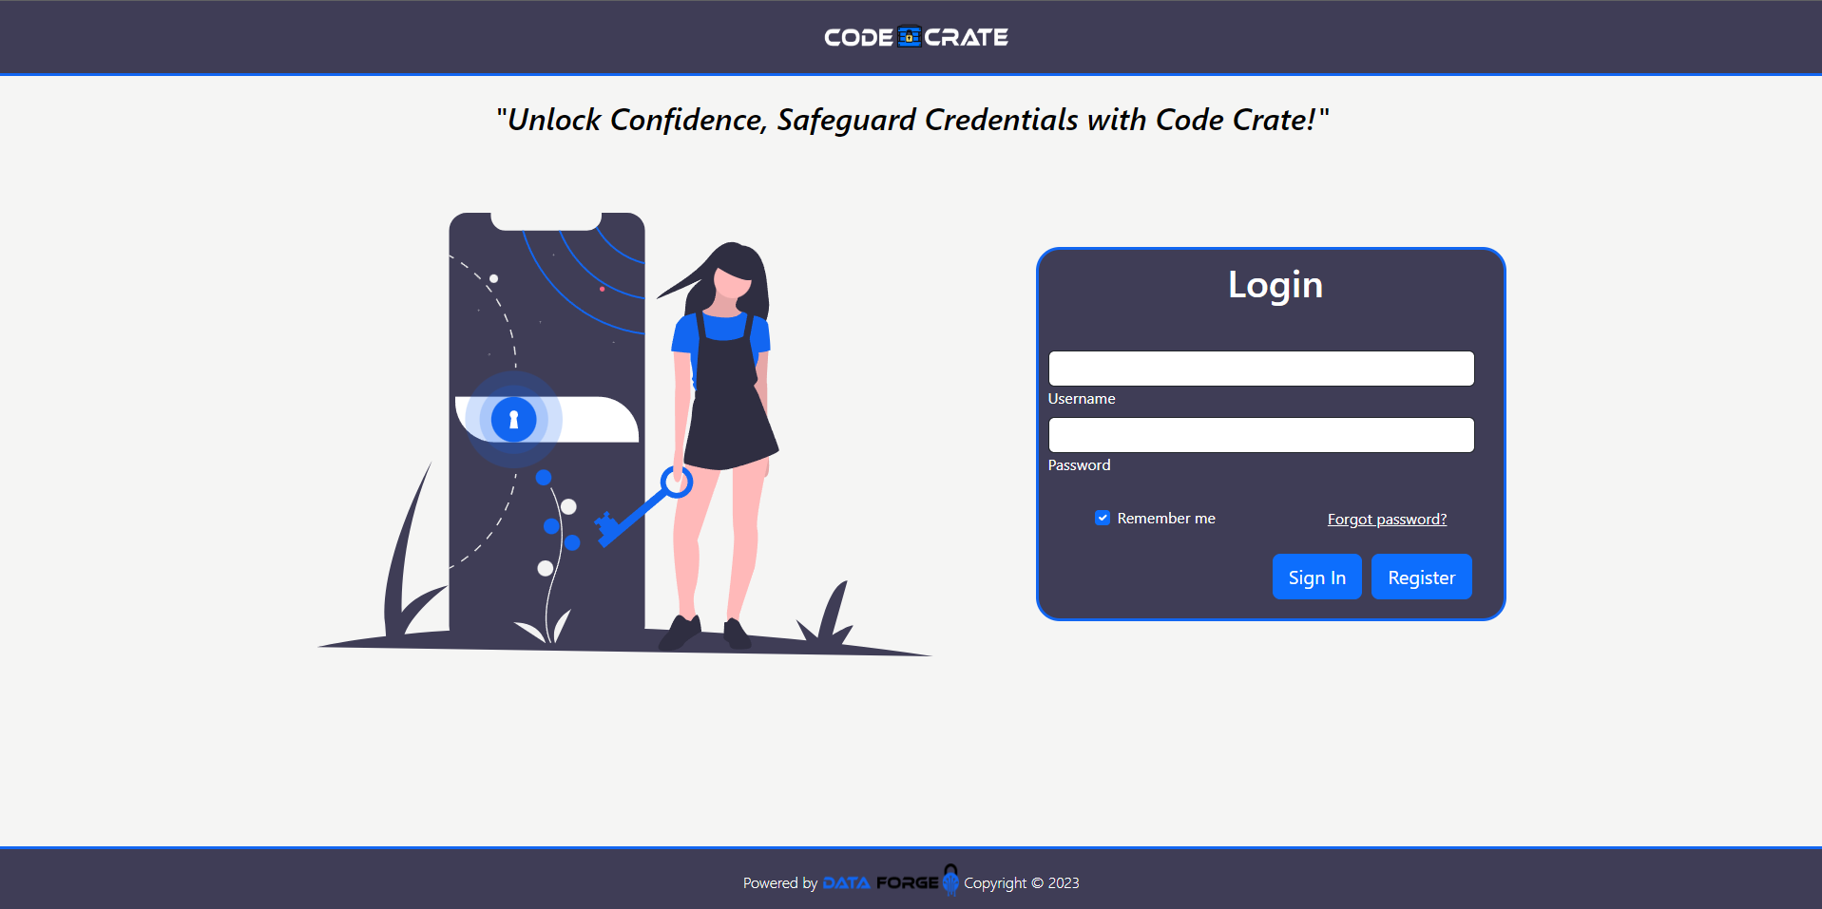
Notes:
Show off the final user interface setup. Would Ryan like to cover this section?

Slide 3
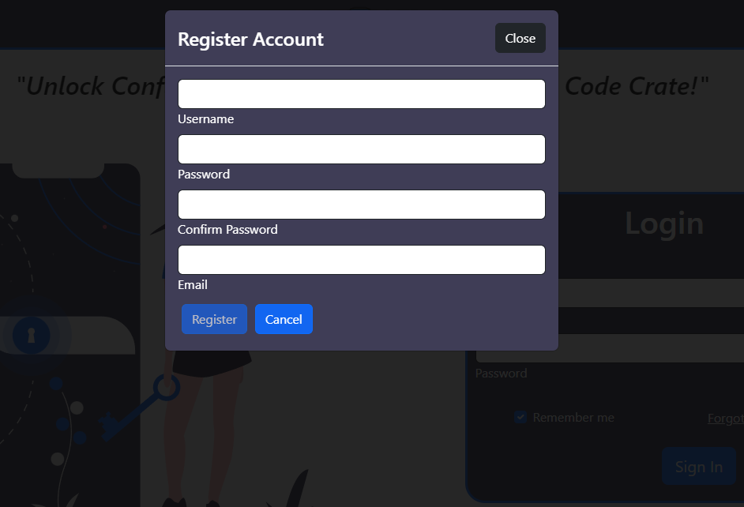

Slide 4
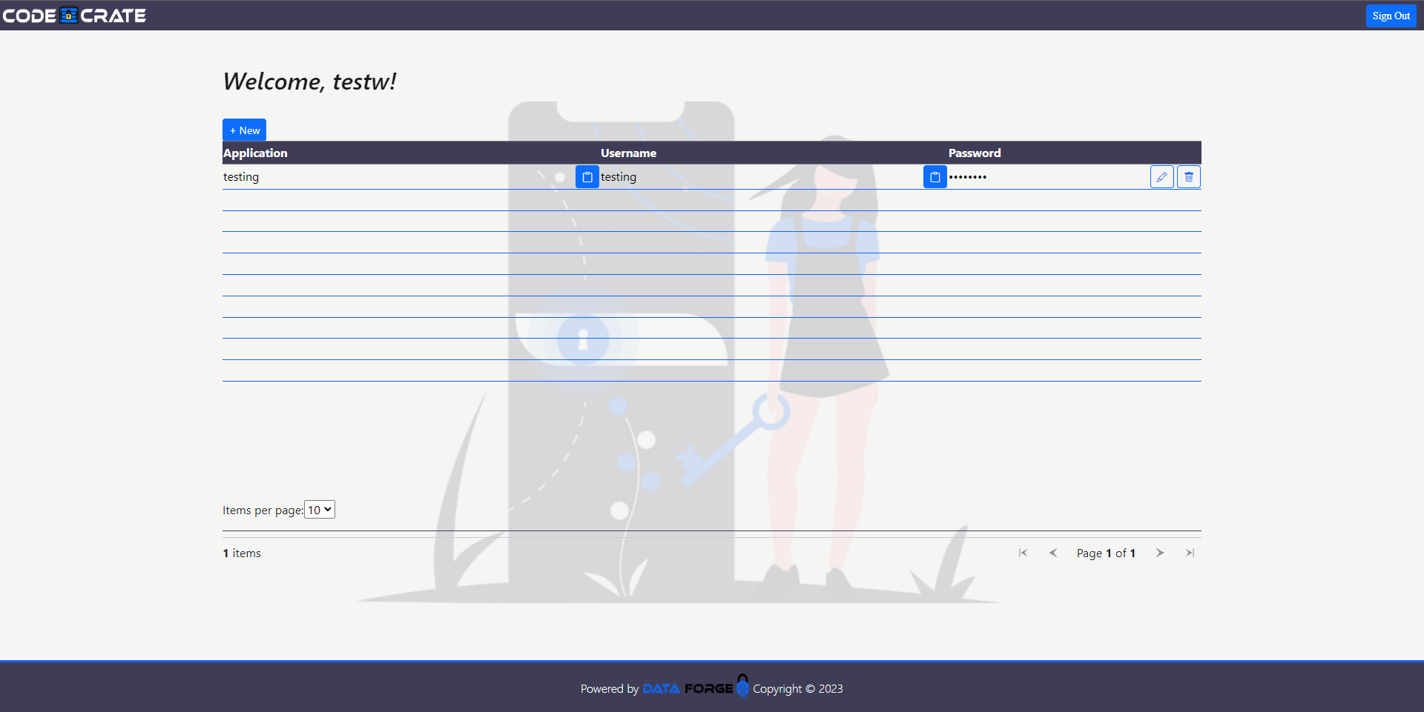
Notes:
Show off the final user interface setup. Would Ryan like to cover this section?

Slide 5
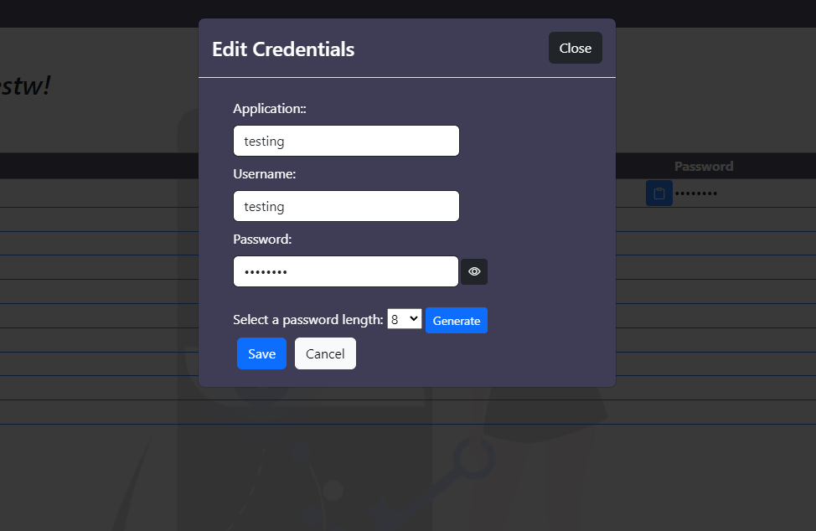

Slide 6
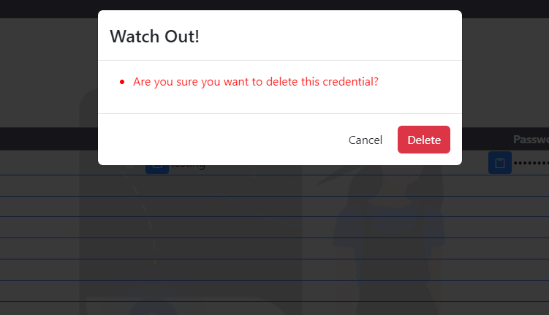

Slide 7
Live Demonstration
Bailey Ducommun
Notes:
From here, Hand off the Zoom Screen share to Bailey or whoever is doing the live demo.

Slide 8
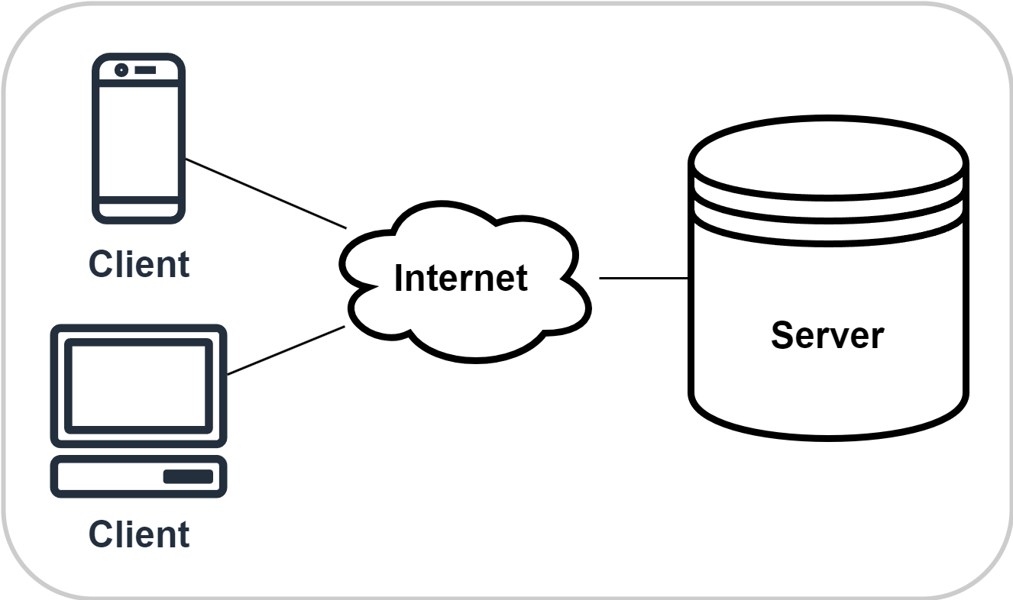
Server Architecture
Code Crate is designed to work on a single server to eliminate unnecessary complexity.
Notes:
Break down the system architecture for the whole program. Using Entity Relation Diagrams and Data Flow Diagrams could help illustrate this. Connor or Phuong should cover this.

Slide 9
Documents completed during Phase 3
Quality Checklist
Used to verify requirements of existing quality assurance workflow
Use Case Document
Used to guide the quality assurance process
Data Flow Diagrams
Created to plan system behavior expectations
Readme on GitHub
Includes instructions for setup, use, third party libraries used, and team credits
Notes:
Go over the documents completed in this phase and how we used them. Connor or Phuong should cover this.

